Slide 1
An Introduction to TDD
Austin Code Day, March 2015

Slide 2
What is a unit test?
A unit test is a piece of code which tests other codes
Unit tests usually cover one public method; any more and you are probably doing too much
Unit tests vs. integration tests

Slide 3
What is TDD?
TDD stands for Test Driven Development
Write your tests before writing any code
Seems counter-intuitive at first, but it can get addicting

Slide 4
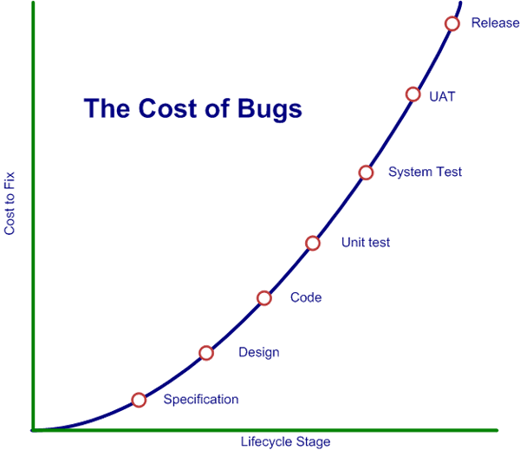
Why TDD?
TDD assists in the design practice
Writing testable code encourages SOLID principles
Gives you confidence to continually refactor
Also gives you the confidence that your code has no unintended side effects
Combined with CI (continuous integration) catching defects early can be extremely valuable
Helps developers sleep at night

Slide 5
Criticisms of TDD (and unit tests in general)
Developer time is not spent producing business value
Poorly written tests can be burdensome

Slide 6
Arrange, Act, Assert
Three phases of most tests:
Arrange: setup your test to run properly
Act: actually execute your SUT (system under test)
Assert: what should happen under these conditions
Do you remember testing as a child?

Slide 7
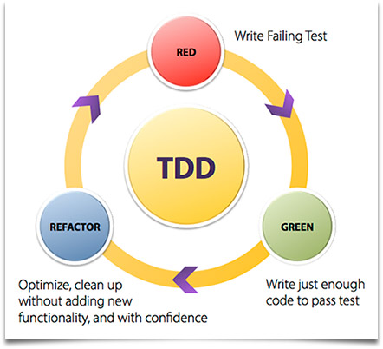
Principles: Red, Green, Refactor

Slide 8
Mock objects
Mock objects are programmer create substitutions for dependent classes
Important concept in unit testing

Slide 9
SOLID Rule of thumbs
Single responsibility principle
You should be able to describe your class using one subject-verb sentence
Open-closed principle
If you add new features, make a subclass and override behavior
Liskov substitution principle
All you should be able to treat all subtypes as a cast of their base type
Interface segregation principle
Keep your interfaces small (less than 6 methods)
Dependency inversion
Program against contracts, not actual classes

Slide 10
Other more concrete rules of thumb:
Most classes should have less than ~300 lines
Most methods should have less than ~30 lines
Most classes should have less than ~10 public methods
Most projects should have less than 3 nested directories
Try not to hard code anything!

Slide 11
Other good principles to know
High cohesion:
Classes and methods do very little, very well
Low Coupling:
Try to make your classes as independent as possible
DRY (Don’t repeat yourself)
KISS (Keep it simple stupid)

